Slide 1

ChIPpeakAnno
8848
Jianhong Ou
Julie Zhu
Notes:
Hello. Thank you for attending advanced bioinformatics. I am Jianhong. Today I will introduce ChIPpeakAnno, a package for batch annotation of the peaks identified from either ChIP-seq, ChIP-chip experiments or any experiments resulted in large number of chromosome ranges. Please do not be hesitate to stop me when you have any question.

Slide 2

Install the workshop pkg
## set the working directory,
## replace "~/Downloads/workshop2020" by your path
wd <- "~/Downloads/workshop2020"
dir.create(wd)
setwd(wd)
library(BiocManager)
install("jianhong/workshop2020", build_vignettes = TRUE)
vignette("ChIPpeakAnno", package="workshop2020")
https://github.com/jianhong/workshop2020
https://bioconductor.org/packages/ChIPpeakAnno
Slides: https://github.com/jianhong/workshop2020/blob/master/inst/extdata/ChIPpeakAnno_workshop2020.pdf
Notes:
Before we start, I suggest you install the workshop2020 package from github. The package contains the vignettes and slides for this workshop. First, set your working directory to a new temporary path. When the workshop finished, you can remove all the files generated in this workshop. And then install the workshop2020 package by BiocManager. It will take lot of time to generate the vignettes. So please do it as earlier as possible. I will leave 1 min to let you type the command here. You can also find the slides at this address. ……..Wait for 1 min here.

Slide 3
A quick history of sequencing
First animal genome – C. elegans (97Mb)
First “next-generation” sequencing
instrument 454 system
Structure of DNA solved
First commercial microarrays
First automated
sequencing machine
First ChIP-seq manuscript
Discovery of DNA
MinION commercially available
1869
1953
1986
1998
2000
2005
2007
2015
2010
ChIPpeakAnno released
1909
1977
1990
2003
2006
2013
2016
the Chromium platform from 10× Genomics
Sanger sequencing invented
First genome sequenced
-– ФX174 (5 kb)
Zebrafish ref. genome
sequenced (Zv9)
Chemical characterization
Human Genome Project
(HGP) started
First RNA-seq manuscript
Completion of HGP (3Gb)
Notes:
In 1869, the DNA was discovered. ….. Until 1990s, human genome project started, which indicated we came to Sequencing Age. In 2006 and 2007, the first manuscripts of RNA-seq and ChIP-seq were published. Since then ChIP-seq almost totally supplanted ChIP-Chip, which was introduced in 1999. Three years later after the ChIP-seq was introduced, Julie Zhu released ChIPpeakAnno package on Bioconductor.

Slide 4
The ENCODE Project Consortium 2011. doi: 10.1371/journal.pbio.1001046
Notes:
Chromatin immunoprecipitation followed by sequencing (ChIP-seq) is a technique for genome-wide profiling of DNA-binding proteins, histone modifications or nucleosomes. – Peter J. Park
ChIP-seq is a directory method to study the regulatory elements, such as enhancers, repressors, promoters, and TFs. It is also idely used technique for histone modifications.

Slide 5
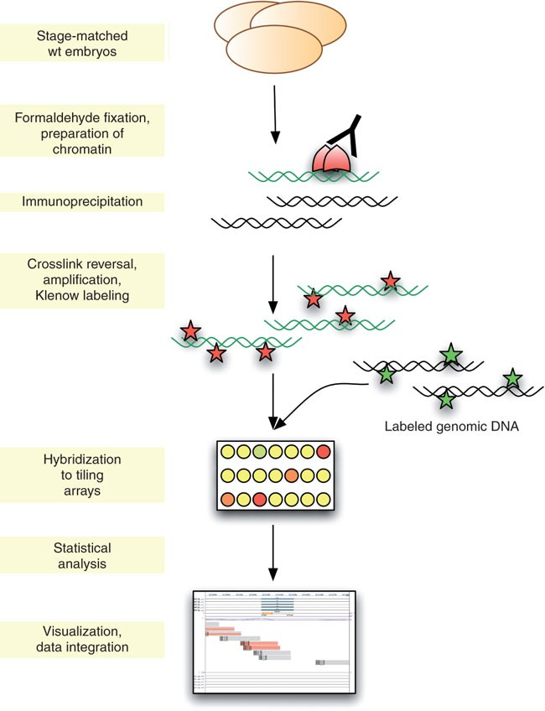
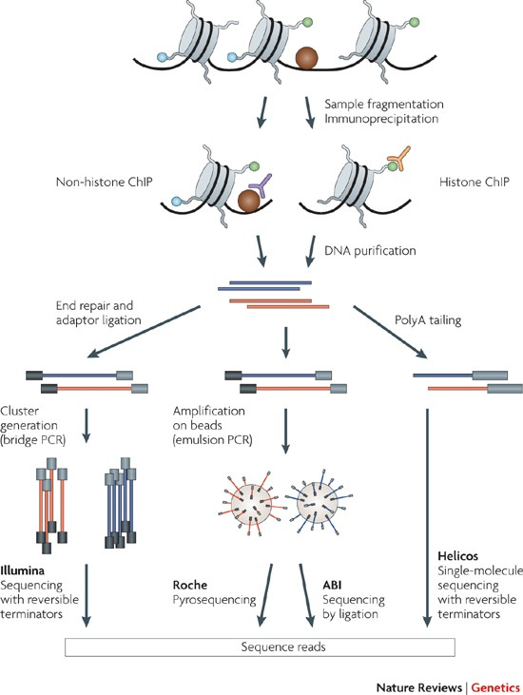
ChIP-Chip ChIP-Seq
Sandmann et.al., 2006. doi: 10.1038/nprot.2006.383
Park 2009. doi:10.1038/nrg2641
Notes:
This chIP-chip or ChIP-seq are used to study the status of chromatin. First, cross-link DNA and protein in the living cell and then fragment the samples. Then use the antibody to pull down the entire complex. And then DNA purification. After that, ChIP-chip is using hybridization to detect the cross-linked DNA, where ChIP-seq is using next generation sequencing to detect the cross-linked targets.
ChIP–seq offers superior data quality ChIP–chip, and its advantages include higher resolution, less noise, higher genome coverage and wider dynamic range.
A population of wild-type (or transgenic) D. melanogaster embryos is dechorionated and covalent bonds between proteins as well as proteins and nucleic acids are introduced by formaldehyde crosslinking. Shearing the DNA allows immunoprecipitation of short sequences associated with the protein of interest. After partial reversal of the crosslinks, these can be amplified, labeled and hybridized against a genomic reference to genomic tiling arrays. Raw data processing followed by statistical analysis allows identification of significantly enriched sequences bound by the protein of interest.
Using chromatin immunoprecipitation (ChIP) followed by massively parallel sequencing, the specific DNA sites that interact with transcription factors or other chromatin-associated proteins (non-histone ChIP) and sites that correspond to modified nucleosomes (histone ChIP) can be profiled. The ChIP process enriches the crosslinked proteins or modified nucleosomes of interest using an antibody specific to the protein or the histone modification. Purified DNA can be sequenced on any of the next-generation platforms¹². The basic concepts are similar for different platforms: common adaptors are ligated to the ChIP DNA and clonally clustered amplicons are generated. The sequencing step involves the enzyme-driven extension of all templates in parallel. After each extension, the fluorescent labels that have been incorporated are detected through high-resolution imaging. On the Illumina Solexa Genome Analyzer (bottom left), clusters of clonal sequences are generated by bridge PCR, and sequencing is performed by sequencing-by-synthesis. On the Roche 454 and Applied Biosystems (ABI) SOLiD platforms (bottom middle), clonal sequencing features are generated by emulsion PCR and amplicons are captured on the surface of micrometre-scale beads. Beads with amplicons are then recovered and immobilized to a planar substrate to be sequenced by pyrosequencing (for the 454 platform) or by DNA ligase-driven synthesis (for the SOLiD platform). On single-molecule sequencing platforms such as the HeliScope by Helicos (bottom right), fluorescent nucleotides incorporated into templates can be imaged at the level of single molecules, which makes clonal amplification unnecessary.

Slide 6
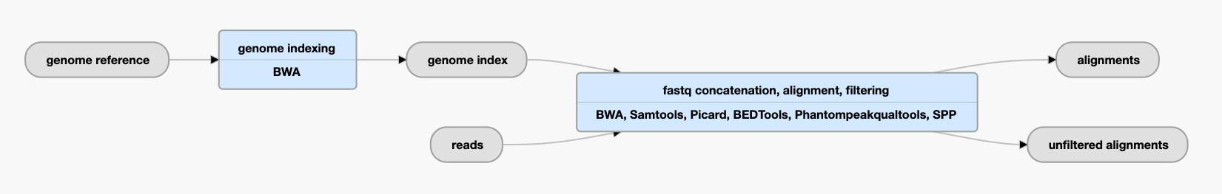
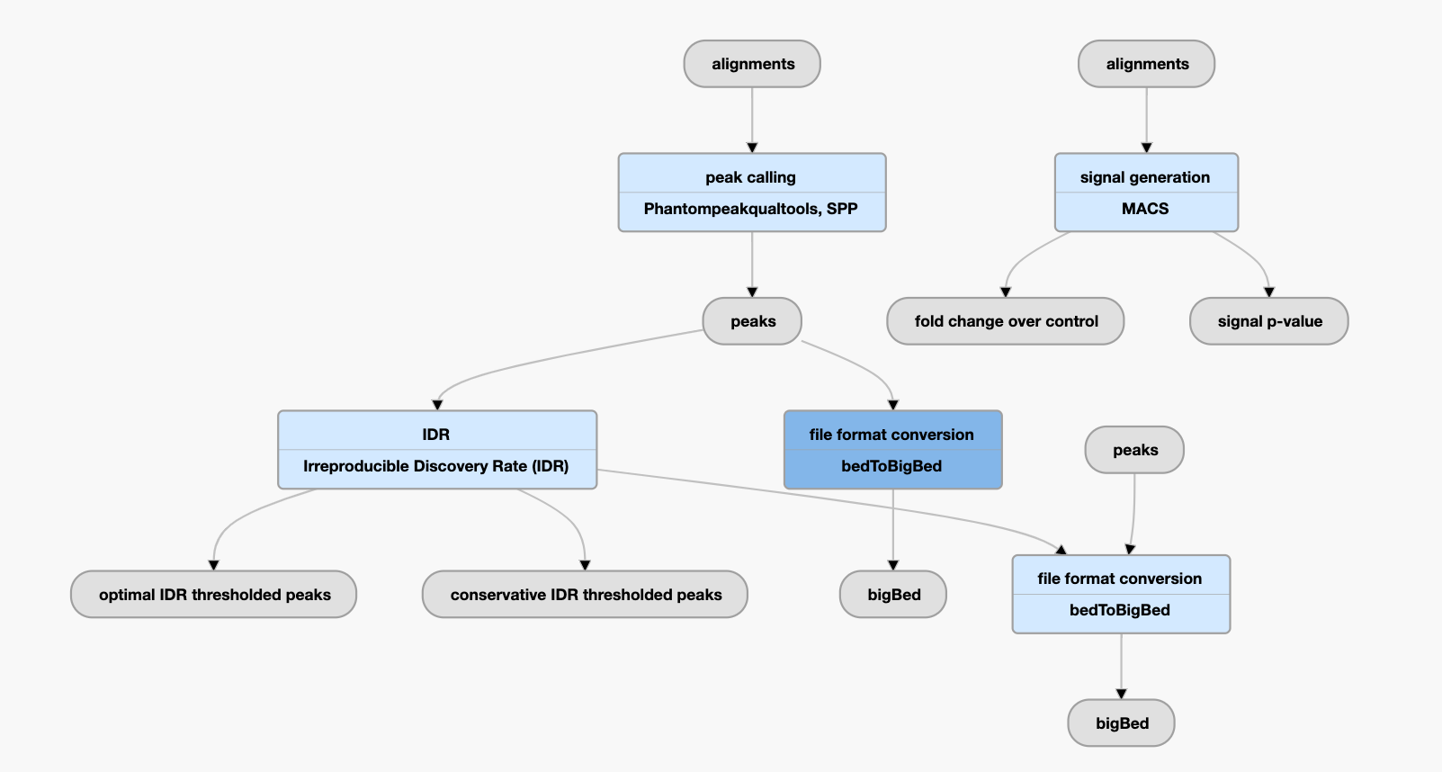
ChIP-seq Data Processing Pipeline from ENCODE project
https://www.encodeproject.org/chip-seq/transcription_factor/
Notes:
Here I show the pipeline of ChIP-seq data processing of ENCODE project. It starts from fastq files. After trimming, aligning, filtering, the peaks will be called by different methods, such as SPP, MACS. The output is bed or bigBed, or narrowPeak, broadPeak, and so on, which contain the peaks coordinates, pvalue, enrichment information.
Many lab using in-house program to annotate the bed files. They don’t think annotation is a difficult work. However, High-throughput experiments are extremely complex, and many steps are involved to generate the report results. It is not possible to say a step is easy or not important. Every step may play a key role in the final result. Every step may introduce variations or errors. And it can be accumulated in the downstream steps of the pipeline. Credible work in this field requires exposure of the entire process, which include the annotation step.

Slide 7







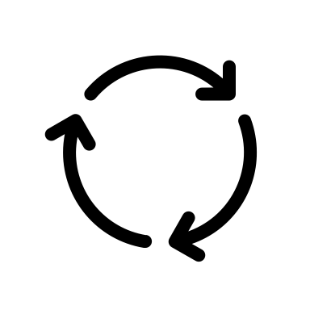






F A I R
Why we need an annotation tool like ChIPpeakAnno?
Findable
Accessible
Interoperable
Reusable
D A T A
Documentation
Autonomy
Traceability
Automation
doi: 10.1093/gigascience/gix100
Reproducibility
The ChIPpeakAnno pkg (PKG in short) is trackable by git version control system. By providing the accurate package versions and annotation resources, the accuracy of an experimental claim can be checked by complete following to the protocol in the published analysis.
Transparency
PKG is open source software. All the source code are accessible from Bioconductor website or GitHub with detailed documentation. There is no hidden step when you publish the annotation method with proper descriptions when citing PKG.
Efficiency
The license of PKG is GPL (>=2). It can be easily re-used with minimal modification or extendention to achieve new functionalities. This is particularly effective because the full documentation and multiple vignettes are available.
Credibility
PKG accepts comments, questions and challenges via Bioconductor support website, email, and GitHub comments. Over 8 years continuous development, PKG become strong and informative to avoid general mistakes in annotation.
Flexibility
PKG provides plenty of parameters to meet the requirements of different annotation context. The implementation of new function is also available on demand.
Feasibility
With well documented functions and vignettes, PKG is feasible for biologists with base R program skills. It is easy to get support from the authors via Bioconductor support website and personal communications.
Notes:
We need an annotation tool like ChIPpeakAnno for several major reasons: Reproducibility, Transparency, Efficiency, credibility, flexibility and feasibility. Which we also called FAIR DATA.

Slide 8







ChIP-chip
ChIP-seq
Downstream peak calling
Image analysis
QA
Background correction
Normalization
Image analysis
QA
Sequence alignment
Peak Calling
Motif analysis
Metagene analysis
Annotation
Overlap analysis
Enrichment
Regulatory Network
Zhu 2013. doi: doi: 10.1007/978-1-62703-607-8_8
Notes:
downstream peak calling includes annotation, motif analysis, overlap analysis and metagene analysis. Once we got annotation, people also do enrichment analysis or regulatory network construction.

Slide 9



































I/O: toGRanges
The toGRanges function Convert UCSC BED format and its variants, such as GFF, or user defined dataset such as MACS output file to GRanges
Main function list
Annotation: annotatePeakInBatch
The annotatePeakInBatch function will obtain the distance to nearest/given-range TSS, miRNA, and /or exons for a list of peak.
Set operation: findOverlapsOfPeaks
The findOverlapsOfPeaks function will findthe overlapped peaks among two or more (less than five) set of peaks.
Enrichment: getEnrichedGO
The getEnrichedGO function obtain the enriched gene ontology (GO) terms that near the peaks.
Metagene: featureAlignedExtendSignal
The featureAlignedExtendSignal function obtain extract signals in given ranges from bam files of DNA-seq. For RNA-seq, use featureAlignedSignal instead.
Motif search: summarizePatternInPeaks
The summarizePatternInPeaks function Output a summary of the occurrence of each pattern in the sequences
Notes:
The package includes functions to perform all the analysis I just mentioned. It can retrieve the sequences around the peak, obtain enriched Gene Ontology (GO) terms, find the nearest gene, exon, miRNA or custom features such as most conserved elements and other transcription factor binding sites supplied by users. The ChIPpeakAnno is a big package, 24 exported function in total. It is not only containing the function listed here, but also a lot of helper functions.

Slide 10
Steps of annotation by ChIPpeakAnno
The functions, toGRanges, annotatePeakInBatch, and addGeneIDs in the ChIPpeakAnno, make the annotation of ChIP-Seq peaks streamlined into four major steps:
Read peak data with toGRanges
Generate annotation data with toGRanges
Annotate peaks with annotatePeakInBatch
Add additional information with addGeneIDs
Notes:
Because the most important function for ChIPpeakAnno is annotation. So I start to introduce the package from annotation. The functions, toGRanges, annotatePeakInBatch, and addGeneIDs in the ChIPpeakAnno, make the annotation of ChIP-Seq peaks streamlined into four major steps: input the peaks, prepare genomic annotations, annotate in batch and add additional information.

Slide 11

0-based vs. 1-based coordinates systems
closed vs. half-open coordinates systems
0-based vs. 1-based coordinates systems
0-based coordinates system start counting from 0 where 1-based coordinates system start counting from 1.
Closed vs. Half-open coordinates systems
A coordinates system use two number to indicate start and end position.
Closed coordinates: [start, end] == start ≤ x ≤ end, where width = end – start + 1
Half-open means half-closed-half-open coordinates: [start, end) == start ≤ x < end, where width = end – start
Most of 0-based coordinates system use half-open coordinates, where 1-based coordinates system use closed coordinates.
1-based coordinates system: SAM, VCF, GFF/GTF and Wiggle formats.
0-based coordinates system: BAM, BCFv2, BED, and PSL formats.
IRanges/GRanges are using closed coordinates system. There is no definition about 0-based or 1-based coordinates for IRanges/GRanges ( IRanges(0, 0) ). The rtracklayer package treat it as 1-based coordinates and ChIPpeakAnno follows this rule.
0/1
]/)
https://genome.ucsc.edu/FAQ/FAQformat.html
Notes:
This slide is for your information. It is good to know it. Even you don't know, it does not hurt when you use ChIPpeakAnno.
0-based and 1 based coordinates systems; closed and half-open coordinates systems.
Programer like 0-based coordinates system because it is easy to operate. For example, by default many program language use 0 to start their index. In C/C++, where we operate pointer, +0 means the address itself and +1 means current address plus 1 structure unit.
Biologists like 1-based coordinates system. The difference is that 0-based coordinates system start counting from 0 where 1-based coordinates system start counting from 1.
Another concept is closed and half-open coordinates systems. A coordinates system use two number to indicate start and end position. There are two kinds of combination for the numbers: 1. start and end; 2 start and step. The following examples use start and end combination.
MACS2, broadpeak, narrowpeak and other BED varitions using 0-based coordinates.
And most of the program can correct handle the coordinates systems so users even did not need to worry this issue at all.

Slide 12
toGRanges
GRanges class peak file
optional
chr7 | 27471196 | 27472363 | Pos1 | 0 | + | 27471196 | 27472363 | 255,0,0
chr7 | 27472363 | 27473530 | Pos2 | 0 | + | 27472363 | 27473530 | 255,0,0
chr7 | 27475864 | 27477031 | Neg1 | 0 | - | 27475864 | 27477031 | 0,0,255
chr7 | 27477031 | 27478198 | Neg2 | 0 | - | 27477031 | 27478198 | 0,0,255
chr7 | 27478198 | 27479365 | Neg3 | 0 | - | 27478198 | 27479365 | 0,0,255
BED format
chrom
chromStart
chromEnd
name
score
strand
thickStart
thickEnd
itemRgb
IRanges(start=NULL, end=NULL, width=NULL, names=NULL, ... ): Creates an IRanges object.
sequence names
coordinates and names
strand information: '+', '-', '*'
GRanges(seqnames=NULL, ranges=IRanges(), strand=NULL, ...,
seqinfo=NULL, seqlengths=NULL): Creates a GRanges object.
chromosome information:
length, is circular or not
chromosome length
Notes:
In ChIPpeakAnno, we use toGRanges to prepare the inputs for annotation. The peak file is read by the toGRanges function. And the genomic features are converted into GRanges from other object by the toGRanges function.
The IRanges object can be constructed by the IRanges function. It ask start, end and width. You just need give two of them, for example start and end, or start and width. The GRanges class is an extended class of IRanges. Before GRanges class was defined, Bioconductor use RangedData. The GRanges class represent the sequence names, coordinates and names, strand information, and additional information about each coordinate. It also represent some information for assembly such as assembly name, chromosome length, chromosome is circular or not. Those information are used to provide double check mechanism for assembly. If your peak lists are mapped to different assembly from your annotation, it will give a warning different set of sequence names or error message for disagreement of sequence lengths.

Slide 13
Input data for annotation, toGRanges
## the sample file is included in ChIPpeakAnno package.
## chage the file path into your own file path to handle your data
path <- system.file("extdata", "Tead4.broadPeak", package="ChIPpeakAnno")
## toGRanges is overlaoded method,
## by define the correct file format to import the file in correct coordinates
peaks <- toGRanges(path, format="broadPeak")
## see top 2 lines of the imported peaks.
## the imported peaks will be packaged into GRanges object
head(peaks, n=2)
## GRanges object with 2 ranges and 4 metadata columns:
## seqnames ranges strand | score signalValue pValue
## <Rle> <IRanges> <Rle> | <integer> <numeric> <numeric>
## peak12338 chr2 175473-176697 * | 206 668.42 -1
## peak12339 chr2 246412-246950 * | 31 100.23 -1
## qValue
## <numeric>
## peak12338 -1
## peak12339 -1
## -------
## seqinfo: 1 sequence from an unspecified genome; no seqlengths
Notes:
Here I show how to input data by the toGRanges function. I will explain it line by line.
pValue - Measurement of statistical significance (-log10). Use -1 if no pValue is assigned.
qValue - Measurement of statistical significance using false discovery rate (-log10). Use -1 if no qValue is assigned.

Slide 14
Important concepts in annotation
Annotation: Computational process of attaching biologically relevant information to a given data.
Assembly: Computational reconstruction of a longer sequence from smaller sequence reads.
Genome assembly: A computational representation of the sequence of a haploid genome, representative of a species or strain.
Notes:
I already mentioned many times of annotation, assembly. Those are important concepts in annotation. Here I am trying to give the definition for those concepts in this workshop context.

Slide 15
Ensembl, RefSeq and UCSC annotations
Ensembl
Ensembl: annotated by genebuild pipeline + manually annotated by the HAVANA team
UCSC: also called "Known Gene", is available only on assemblies before hg38. It was built with UCSC gene predictor which uses protein, EST and cDNA annotations.
RefSeq: most stringent. RefSeq also have additional sequences independent of the genome assembly. This has the important implication that the position of genome variants are harder to map to RefSeq transcripts.
33135
1369
21958
For RNA-seq:
Less complex genome annotations, such as RefGene, are preferable for reproducible and robust gene expression estimates.
However, to discover and explain unknown biological mechanisms, more comprehensive and complex genome annotations are necessary, such as Ensembl.
Wu et.al., 2013. doi: 0.1186/1471-2105-14-S11-S8
951
168
RefGene
882
5434
UCSC
The overlap and intersection among RefGene, UCSC(hg19), and Ensembl (GRCh37) annotations
The overlap and intersection among RefGene, UCSC(hg19), and Ensembl (GRCh37) annotations
Zhao et.al., 2015. doi: 10.1186/s12864-015-1308-8
Notes:
There are many published annotations system, such as ensembl, UCSC, and refSeq. For different species, there are different popular databased, such as flybase, wormbase, zfin, MGI, and SGD.
The difference between Ensembl and UCSC is that they are using different pipeline to annotate automatically to same assembly. Ensembl use genebuild pipeline and UCSC use UCSC gene predictor.
What's more, Ensembl also shows transcripts that are manually annotated by the HAVANA team. If the Ensembl and Havana annotation agree with each other the transcripts are combined into an Ensembl/Havana merged transcript. When a transcript is only annotated by Ensembl or Havana it is named an Ensembl or Havana transcript, respectively.
It is not strange that Ensembl have more than 50% genes are unique.
The overlap and intersection among RefGene, UCSC, and Ensembl annotations. In general, different annotations have very high overlaps: there are about 22K common genes shared by all three gene models. RefGene has the fewest unique genes.

Slide 16
Genome assembly versions
SPECIES | UCSC VERSION | RELEASE DATE | Ensembl VERSION | RELEASE DATE | ASSEMBLY NAME
Human | hg38 | Dec. 2013 | GRCh38 | P13: Sep. 2019 (>=V98); P12: Apr. 2018 (>=V92, <=V97); P10: Mar. 2017 (>=V88, <=V91); P7: Jul. 2016 (>=V85, <=V87); P5: Dec. 2015 (>=V83, <=V84); P3: Jul. 2015 (>=V81, <=V82); P2: Mar. 2015 (>=V79, <=V80); Aug. 2014 (>=V76, <=V78); | Genome Reference Consortium GRCh38
 | hg19 | Feb. 2009 | GRCh37 | P13: Dec. 2013 (>=V74, <=V75); P12: Sep. 2013 (=V73); P11: Jun. 2013 (=V72); P10: Apr. 2013 (=V71); P8: Jul. 2012 (>=V68, <=V70); P7: May 2012 (=V67); P6: Feb. 2012 (=V66); P5: Sep. 2011 (>=V64, <=V65); P3: Jun. 2011 (=V63); Jul. 2009 (>=V55, <=V62); | Genome Reference Consortium GRCh37
Mouse | mm10 | Dec. 2011 | GRCm38 | P6: Apr. 2018 (>=V92); P5: Dec. 2016 (>=V87, <=V91); P4: Jul. 2015 (>=V81, <=V86); P3: Dec. 2014 (>=V78, <=V80); P2: Dec. 2013 (>=V74, <=V77); P1: Jan. 2013 (>=V70, <=V73); Jul. 2012 (>=V68, <=V69) | Genome Reference Consortium GRCm38
 | mm9 | Jul. 2007 | NCBIM37 | Oct. 2007(>=V47) | NCBI Build 37
Zebrafish | danRer11 | May 2017 | GRCz11 | Apr. 2018 (>=V92) | Genome Reference Consortium GRCz11
 | danRer10 | Sep. 2014 | GRCz10 | May 2015 (>=V80, <=V91) | Genome Reference Consortium GRCz10
D. melanogaster | dm6 | Aug. 2014 | BDGP6 | Mar. 2015 (>=V79) | BDGP Release 6 + ISO1 MT
 | dm3 | Apr. 2006 | BDGP5 | NA | BDGP Release 5
C. elegans | ce11 | Feb. 2013 | WBcel235 | Apr. 2013 (>=V71) | C. elegans Sequencing Consortium WBcel235
 | ce10 | Oct. 2010 | WS220 | Feb. 2011 (>=V61, <=V66) | WormBase v. WS220
https://genome.ucsc.edu/FAQ/FAQreleases.html
https://useast.ensembl.org/info/website/archives/assembly.html
Notes:
For UCSC and Ensembl, they named the annotation for same assembly with different names. I list some of them here. To get more information, please read the documentation in their websites.
For example, …

Slide 17

Prepare annotation data, toGRanges
library(TxDb.Hsapiens.UCSC.hg19.knownGene)
annoData <- toGRanges(TxDb.Hsapiens.UCSC.hg19.knownGene, feature="gene")
annoData[1]
## GRanges object with 1 range and 0 metadata columns:
## seqnames ranges strand
## <Rle> <IRanges> <Rle>
## 1 chr19 58858172-58874214 –
## -------
## seqinfo: 93 sequences (1 circular) from hg19 genome
Notes:
The toGRanges function is overloaded function. It can also be used to prepare the annotation data by converting annotation data in other format into GRanges.
Here I am showing how to use toGRanges to convert TxDb into GRanges. I set the feature level as gene. You can also try to set it as a different level such as “exon”, and “transcript”. For more details, you can always check the documentation.

Slide 18
Annotate by annotatePeakInBatch
output
FeatureLocForDistance: TSS
PeakLocForDistance: start
result
geneA
geneB
nearestLocation
geneB
geneA
geneB
shortestDistance
geneA
overlapping
maxgap = 5K
geneA
geneC
geneB
geneA, B, C
5K
5K
nearestBiDirectionalPromoters
bindingRegion = c(-5000, 200)
geneA
geneC
geneB
geneA, C
5K
200
Notes:
We already have peak list and annotation data in R. The next step is to use annotatePeakInBatch to connect them. The annotatePeakInBatch function provides multiple annotation methods by sets of different parameters. FeatureLocFordistance can be set as TSS, geneEnd and middle. The PeakLocForDistance can be set as start, end and middle. Here we use TSS for FeatureLocForDistance and set start for PeakLocForDistance. And then we compare the results by set the parameter output into different values. … Then the next question is how to set the features.

Slide 19
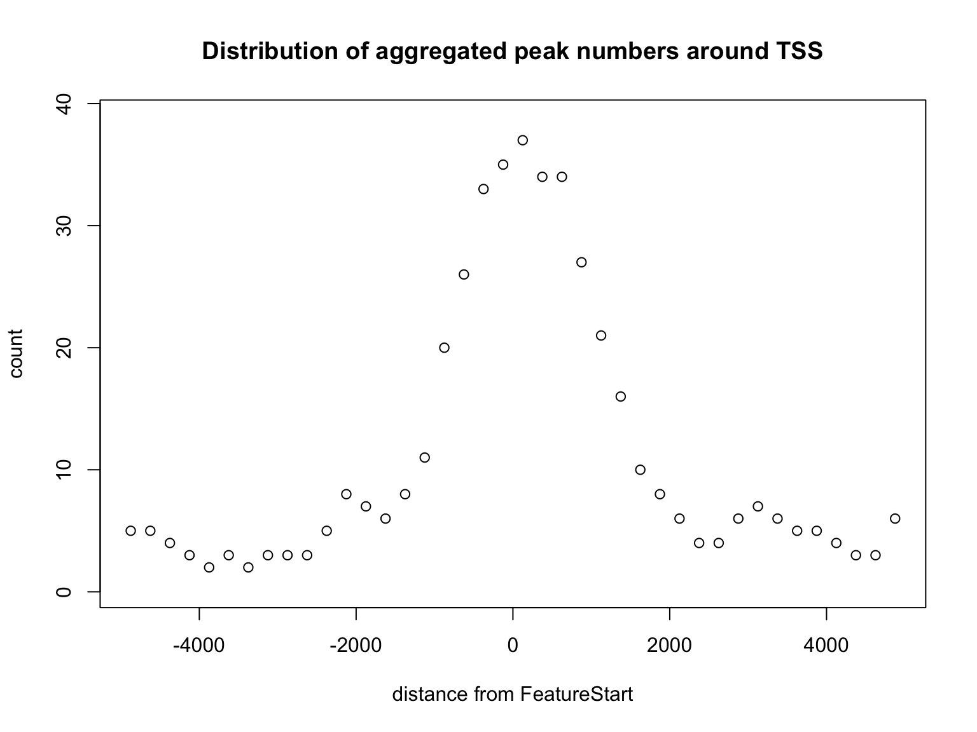
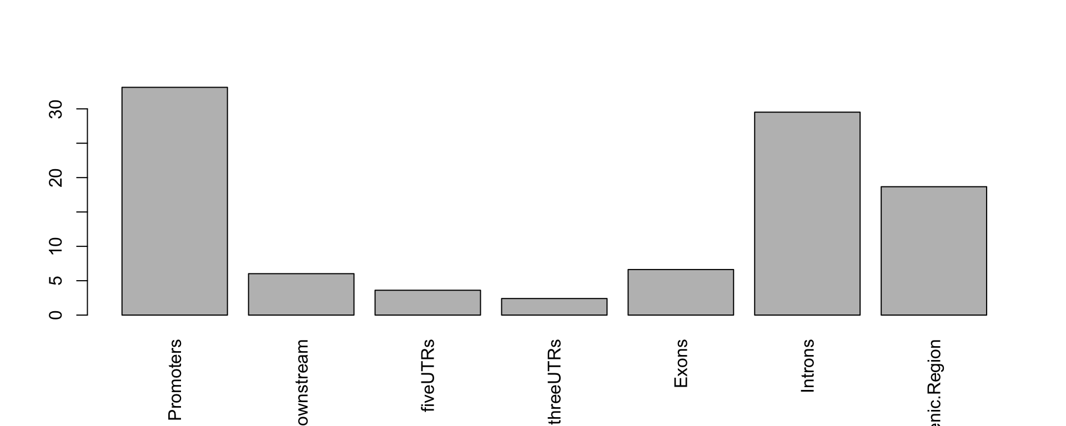
Select annotation method
Visualize binding site distribution relative to features
aCR<-assignChromosomeRegion(overlaps,
nucleotideLevel=FALSE,
precedence=c("Promoters", "immediateDownstream", "fiveUTRs", "threeUTRs", "Exons", "Introns"),
TxDb=TxDb.Hsapiens.UCSC.hg19.knownGene)
barplot(aCR$percentage, las=3)
binOverFeature(overlaps, annotationData=annoDataTxDb,
radius=5000, nbins=20, FUN=length,
errFun=0, ylab="count",
main="Distribution of aggregated peak numbers around TSS")
upstream
5' UTR
CDS
3' UTR
downstream
TSS
TES
Intergenic
Intron
Intergenic
Notes:
To determine that we can use helper function assignChromosomeRegion and binOverFeature. The assignChromosomeRegion function can be used to summarize the distribution of peaks over different type of features such as exon, intron, enhancer, proximal promoter, 5’ UTR and 3’ UTR. This distribution can be summarized in peak centric or nucleotide centric view using the function assignChromosomeRegion. Please note that one peak might span multiple type of features, leading to the number of annotated features greater than the total number of input peaks. At the peak centric view, precedence will dictate the annotation order when peaks span multiple type of features.
The sample code here plots the distribution of peaks are enriched around the promoters.
In addition, the distribution of the distance of overlapped peaks to the nearest feature such as the transcription start sites (TSS) can be plotted by the binOverFeature function. The sample code here plots the distribution of peaks around the TSS.

Slide 20
Annotate data by nearest features
## keep the seqnames in the same style
if(!identical(seqlevelsStyle(peaks), seqlevelsStyle(annoDataTxDb))){
seqlevelsStyle(peaks) <- seqlevelsStyle(annoDataTxDb)[1]
}
## do annotation by nearest TSS of UCSC hg19 annotations
annoTxDb <- annotatePeakInBatch(peaks, AnnotationData=annoDataTxDb)
head(annoTxDb, n=1)
## GRanges object with 1 ranges and 13 metadata columns:
## seqnames ranges strand | score signalValue
## <Rle> <IRanges> <Rle> | <integer> <numeric>
## peak12338.26751 chr2 175473-176697 * | 206 668.42
## pValue qValue peak feature start_position
## <numeric> <numeric> <character> <character> <integer>
## peak12338.26751 -1 -1 peak12338 26751 218136
## end_position feature_strand insideFeature distancetoFeature
## <integer> <character> <character> <numeric>
## peak12338.26751 264810 - downstream 89337
## shortestDistance fromOverlappingOrNearest
## <integer> <character>
## peak12338.26751 41439 NearestLocation
## -------
## seqinfo: 1 sequence from an unspecified genome; no seqlengths
Notes:
Here I show the sample code to annotate data by nearest features. We must keep the seqnames in the same style. For example, for UCSC, they use seqlevels style "chr"+num, where, Ensembl they use num whithout "chr" in front.

Slide 21

Location
Add additional annotation, addGeneIDs
annoTxDb <- addGeneIDs(annoTxDb, orgAnn="org.Hs.eg.db", feature_id_type="entrez_id", IDs2Add=c("symbol"))
head(annoTxDb, n=2)
Use "entrez_id" for TxDb annotations;
Use ”ensemble_gene_id" for EnsDb annotations;
## GRanges object with 2 ranges and 14 metadata columns:
## seqnames ranges strand | score signalValue
## <Rle> <IRanges> <Rle> | <integer> <numeric>
## peak12338.26751 chr2 175473-176697 * | 206 668.42
## peak12339.26751 chr2 246412-246950 * | 31 100.23
## pValue qValue peak feature start_position
## <numeric> <numeric> <character> <character> <integer>
## peak12338.26751 -1 -1 peak12338 26751 218136
## peak12339.26751 -1 -1 peak12339 26751 218136
## end_position feature_strand insideFeature distancetoFeature
## <integer> <character> <character> <numeric>
## peak12338.26751 264810 - downstream 89337
## peak12339.26751 264810 - inside 18398
## shortestDistance fromOverlappingOrNearest symbol
## <integer> <character> <character>
## peak12338.26751 41439 NearestLocation SH3YL1
## peak12339.26751 17860 NearestLocation SH3YL1
## -------
## seqinfo: 1 sequence from an unspecified genome; no seqlengths
Notes:
And add additional annotation by addGeneIDs.

Slide 22
GOTO vignette
Notes:
Stop at next slide

Slide 23
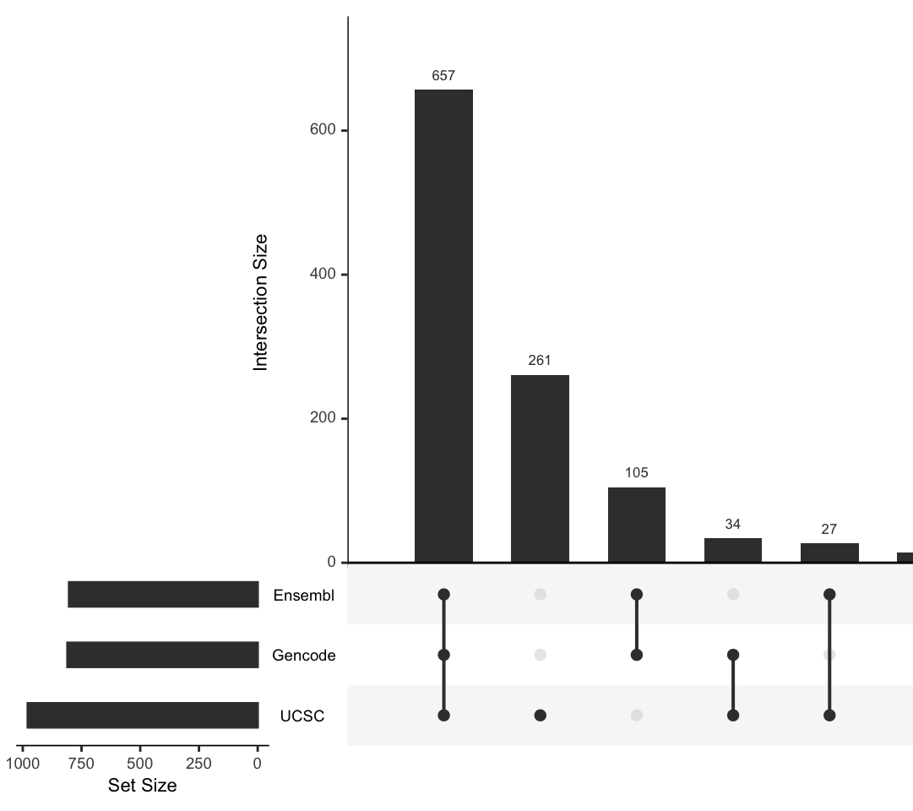
Annotations with different annotation source
As a conclusion, annotate with different annotation resources, even the other parameter keep same, the annotations will be different from each other. To improve the reproducibility, accuracy of an annotation source should be provided.
upset plot of common gene symbols among annotations by Ensembl, UCSC and Gencode features.

Slide 24
Find overlaps for replicates, findOverlapsOfPeaks
## import peaks from a bed file
bed <- system.file("extdata", "MACS_output.bed", package="ChIPpeakAnno")
gr1 <- toGRanges(bed, format="BED", header=FALSE)
## import peaks from a gff file
gff <- system.file("extdata", "GFF_peaks.gff", package="ChIPpeakAnno")
gr2 <- toGRanges(gff, format="GFF", header=FALSE, skip=3)
## find overlaps for replicates
ol <- findOverlapsOfPeaks(gr1, gr2, connectedPeaks = "keepAll")
head(ol$peaklist[["gr1///gr2"]], n=2)
## GRanges object with 2 ranges and 2 metadata columns:
## seqnames ranges strand | peakNames
## <Rle> <IRanges> <Rle> | <CharacterList>
## [1] chr1 713791-715578 * | gr1__MACS_peak_13,gr2__001,gr2__002
## [2] chr1 724851-727191 * | gr2__003,gr1__MACS_peak_14
## -------
## seqinfo: 1 sequence from an unspecified genome; no seqlengths
Notes:
Find overlaps of two or more peak lists are a common task in ChIP-seq results analysis when we compare the correlation among replicates or check co-localization between different TFs. The findOverlapsOfPeaks function can find up to 5 lists of peaks. Here I show the example for finding the overlaps for duplicates.

Slide 25
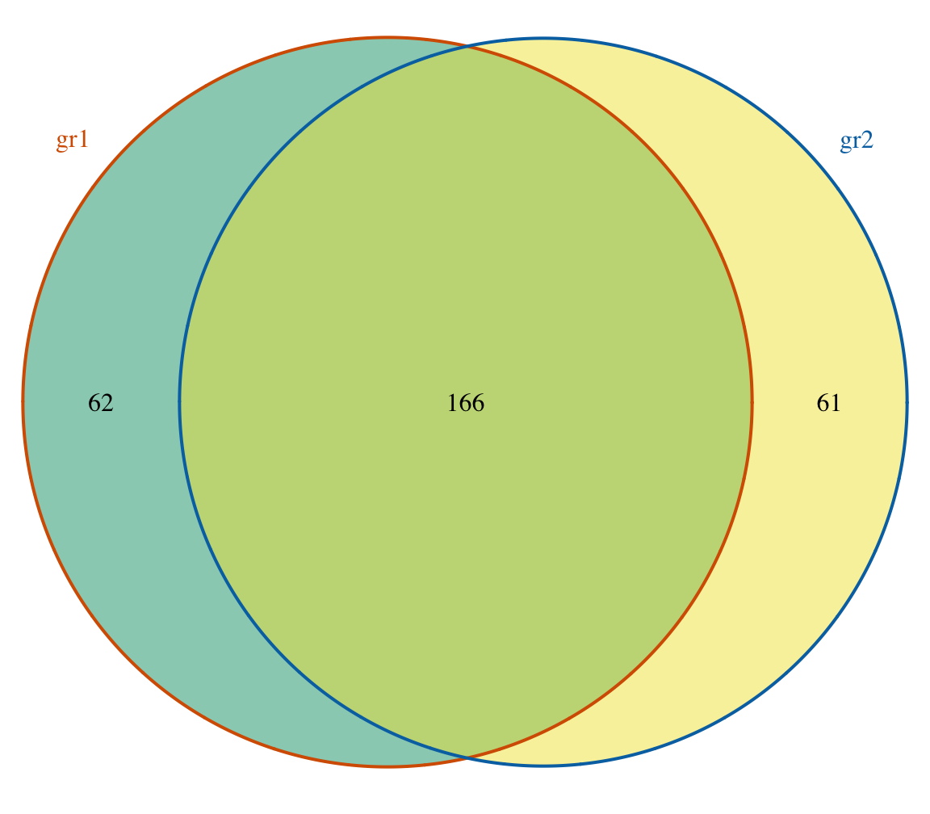
Find overlaps for replicates, findOverlapsOfPeaks
makeVennDiagram(ol, fill=c("#009E73", "#F0E442"),
col=c("#D55E00", "#0072B2"),
cat.col=c("#D55E00", "#0072B2"))
connectedPeaks:
"min" : minimal involved peaks → 2
"merge" : 1
"keepAll": keep all the original counts for each list while the final counts will be same as "min"
Sample A
Sample B
Notes:
We can use makeVennDiagram to plot a venn diagram. However, we often find that the total number shown in the venn diagram is not identical with original counts for each list. This is because the overlaps may contain multiple peaks for one or more samples. For example here, in the overlapping peak, there are 3 peaks in sample A, where 2 peaks in sample B. By setting connectedPeaks parameter, the findOverlapsofpeaks will output different numbers.

Slide 26
GOTO vignette
Notes:
Stop at next slide

Slide 27
Enrichment: Obtain enriched GO terms and Pathways
Use getEnrichedGO to obtain a list of enriched GO terms with annotated peaks. For pathway analysis, please use function getEnrichedPATH with reactome or KEGG database.
getEnrichedGO(annotatedPeak, orgAnn,
feature_id_type="ensembl_gene_id",
maxP=0.01, minGOterm=10,
multiAdjMethod=NULL,
condense=FALSE,
removeAncestorByPval=NULL,
keepByLevel=NULL)
getEnrichedPATH(annotatedPeak, orgAnn,
pathAnn,
feature_id_type="ensembl_gene_id",
maxP=0.01,
minPATHterm=10,
multiAdjMethod=NULL)
The getEnrichedGO function obtain enriched gene ontology (GO) terms based on the features near the enriched peaks using GO.db package and GO gene mapping package such as org.Hs.db.eg to obtain the GO annotation and using hypergeometric test (phyper) and multtest package for adjusting p-values.
The getEnrichedPATH function obtain enriched PATH that are near the peaks using path package such as reactome.db and path mapping package such as org.Hs.db.eg to obtain the path annotation and using hypergeometric test (phyper) and multtest package for adjusting p-values.

Slide 28
GOTO vignette
Notes:
Stop at next slide

Slide 29
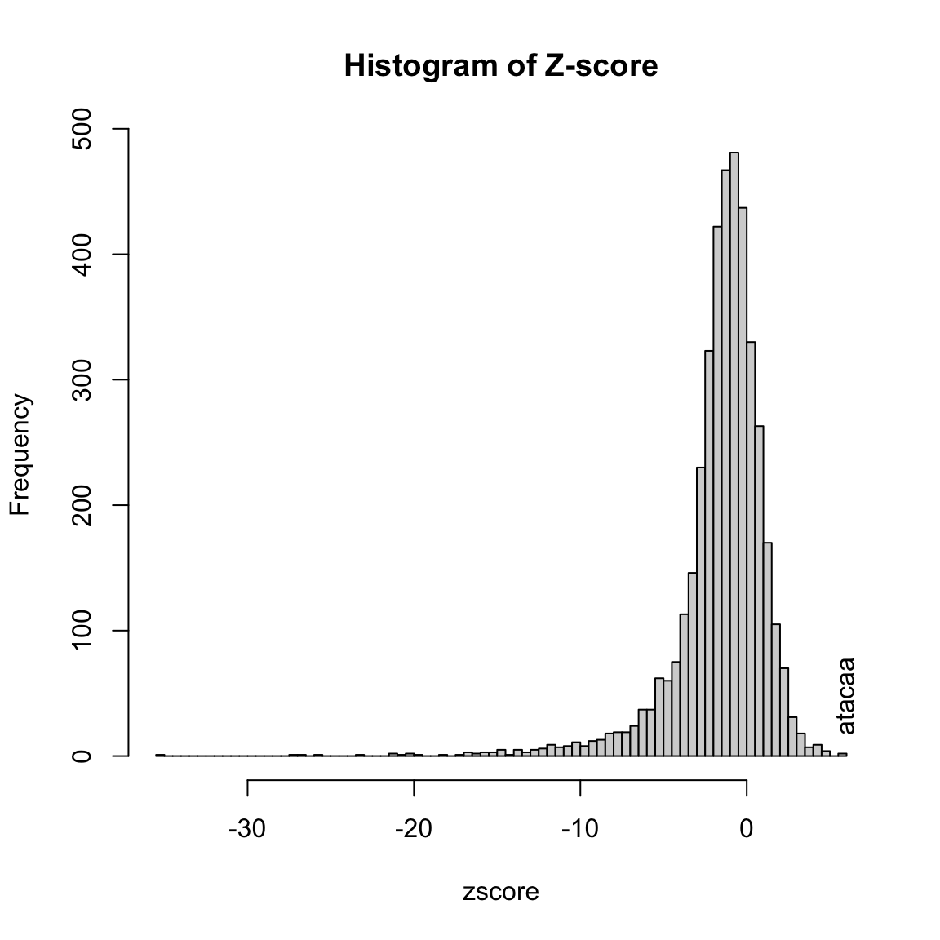
Motif search: Output a summary of consensus in the peaks
There are multiple methods to get the consensus in the peaks:
output the fasta file by the getAllPeakSequence function and search the motif by the 3rd program such as homer, MEME, and so on.
test the pre-defined consensus patterns to see if target consensus are enriched or not by the summarizePatternInPeaks function.
calculate the z-scores of all combinations of oligonucleotide in a given length by Markove chain by the oligoSummary function.

Slide 30
GOTO vignette
Notes:
Stop at next slide

Slide 31
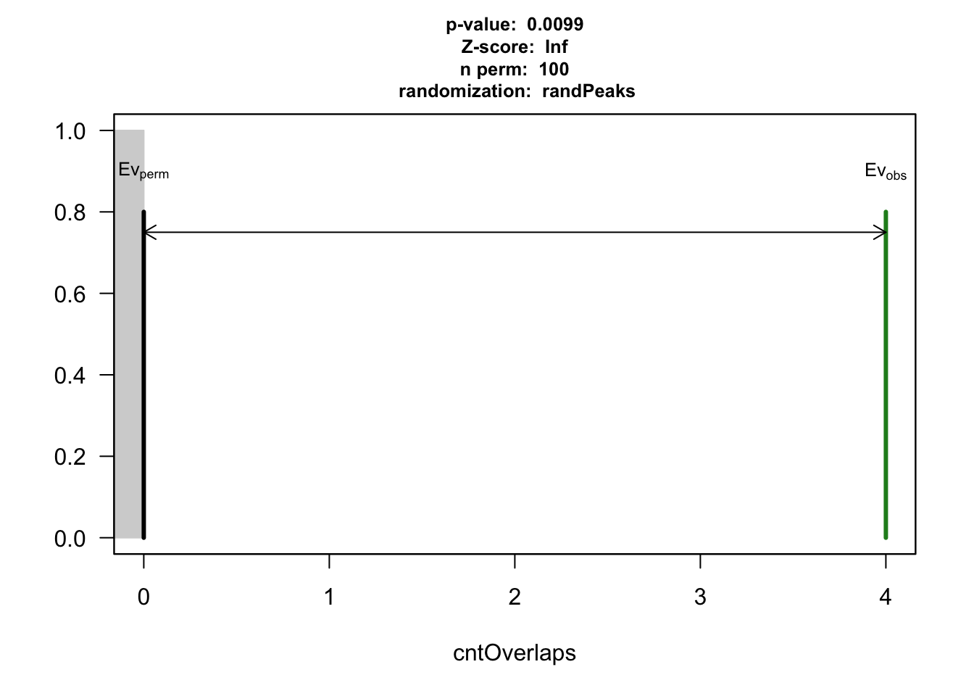
Determine if there is a significant overlap among multiple sets of peaks
makeVennDiagram: The p.value is calculated by hypergeometric test to determine whether the peaks or features are overlapped significantly. The number of all potential binding sites is required.
peakPermTest: Performs a permutation test to see if there is an association between two given peak lists.
## $p.value
## TAF Tead4 YY1 pval
## [1,] 0 1 1 1.000000e+00
## [2,] 1 0 1 2.904297e-258
## [3,] 1 1 0 8.970986e-04
##
## $vennCounts
## TAF Tead4 YY1 Counts count.TAF count.Tead4 count.YY1
## [1,] 0 0 0 849 0 0 0
## [2,] 0 0 1 621 0 0 621
## [3,] 0 1 0 2097 0 2097 0
## [4,] 0 1 1 309 0 310 319
## [5,] 1 0 0 59 59 0 0
## [6,] 1 0 1 166 172 0 170
## [7,] 1 1 0 8 8 8 0
## [8,] 1 1 1 476 545 537 521
## attr(,"class")
## [1] "VennCounts"
Notes:
Given two or more peak lists from different TFs, one may be interested in finding whether DNA binding profile of those TFs are correlated, and if correlated, what is the common binding pattern.

Slide 32
GOTO vignette
Notes:
Stop at next slide

Slide 33

Save annotation results
library(WriteXLS)
WriteXLS(as.data.frame(unname(overlaps.anno)), "anno.xls")
The annotation results can be saved in XLS file format using WriteXLS package to avoid the gene name errors that can be inadvertently introduced when opened by Excel.
Zeeberg et.al., 2004. doi: 10.1186/1471-2105-5-80

Slide 34
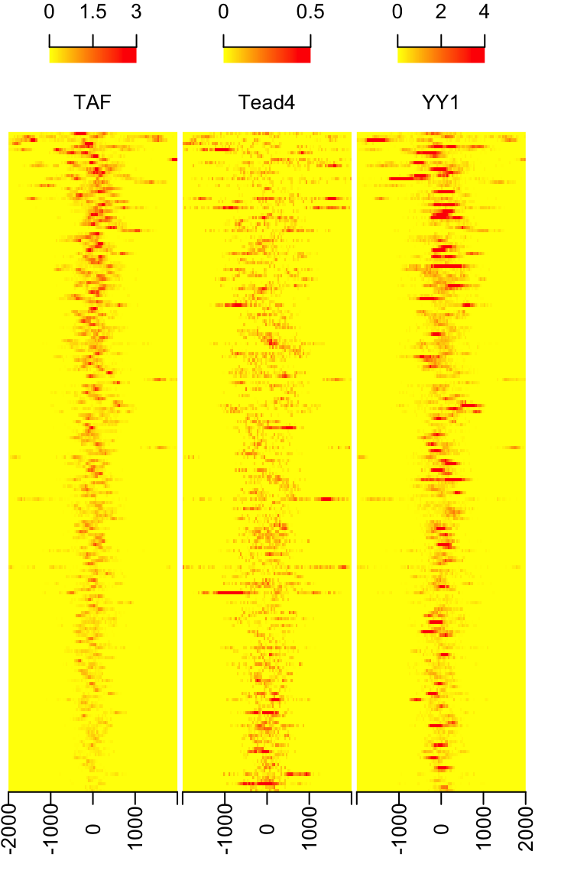
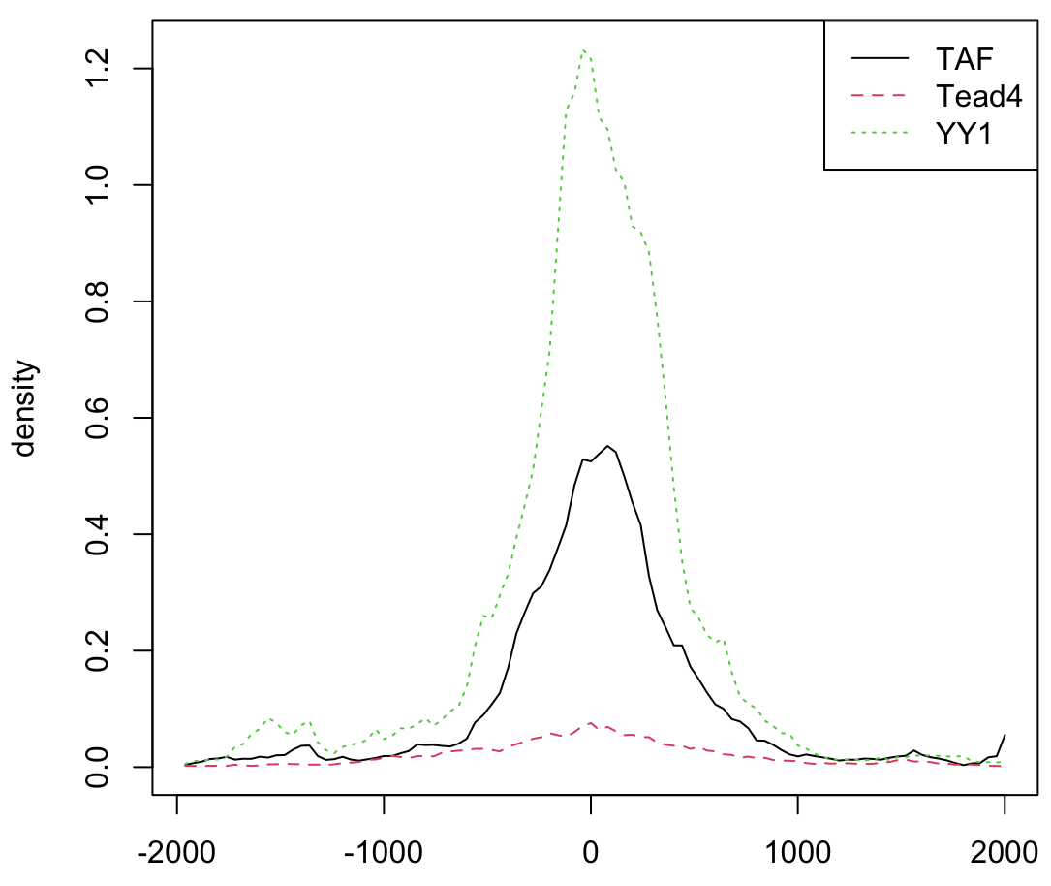
Metagene analysis for given features/peaks
The featureAlignedExtendSignal function obtain extract signals in given ranges from bam files of DNA-seq. For RNA-seq, use featureAlignedSignal instead. Function featureAlignedHeatmap and featureAlignedDistribution can be used to visualize and compare the binding patterns of raw signals of multiple ChIP-Seq experiments.

Slide 35
GOTO vignette
Notes:
Stop at next slide

Slide 36

ChIPpeakAnno Can…
Annotation: annotatePeakInBatch
The annotatePeakInBatch function will obtain the distance to nearest/given-range TSS, miRNA, and /or exons for a list of peak.
I/O: toGRanges
The toGRanges function Convert UCSC BED format and its variants, such as GFF, or user defined dataset such as MACS output file to GRanges
Enrichment: getEnrichedGO/PATH
The getEnrichedGO and getEnrichedPATH function obtain the enriched gene ontology (GO) terms that near the peaks.
Set operation: findOverlapsOfPeaks
The findOverlapsOfPeaks function will findthe overlapped peaks among two or more (less than five) set of peaks.
Metagene: featureAlignedExtendSignal
The featureAlignedExtendSignal function obtain extract signals in given ranges from bam files of DNA-seq. For RNA-seq, use featureAlignedSignal instead.
Motif search: oligoSummary
The summarizePatternInPeaks and oligoSummary function Output a summary of the occurrence of each pattern or all combinations of oligonucleotide in the sequences

Slide 37
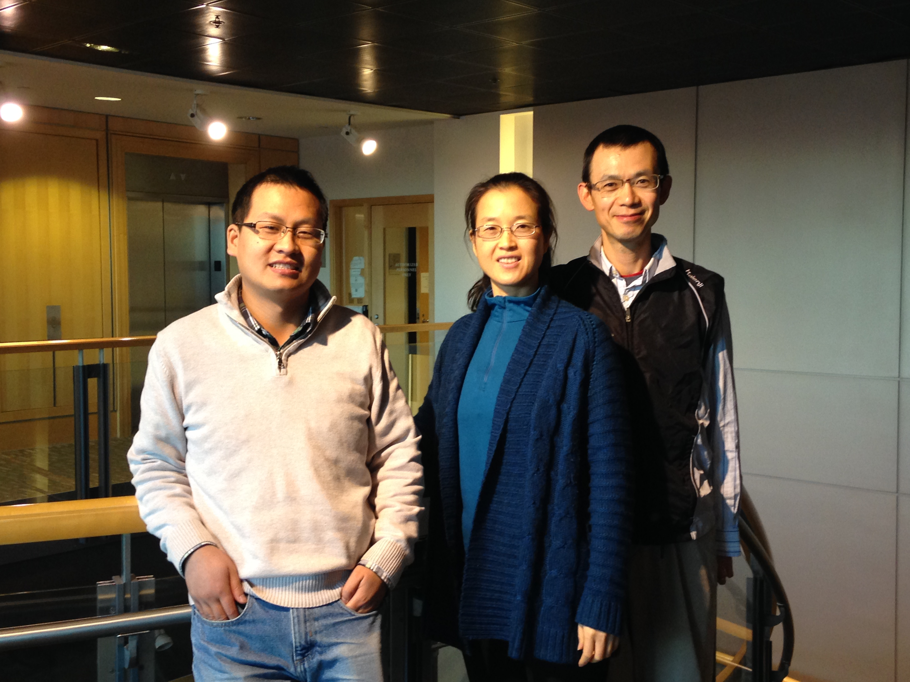
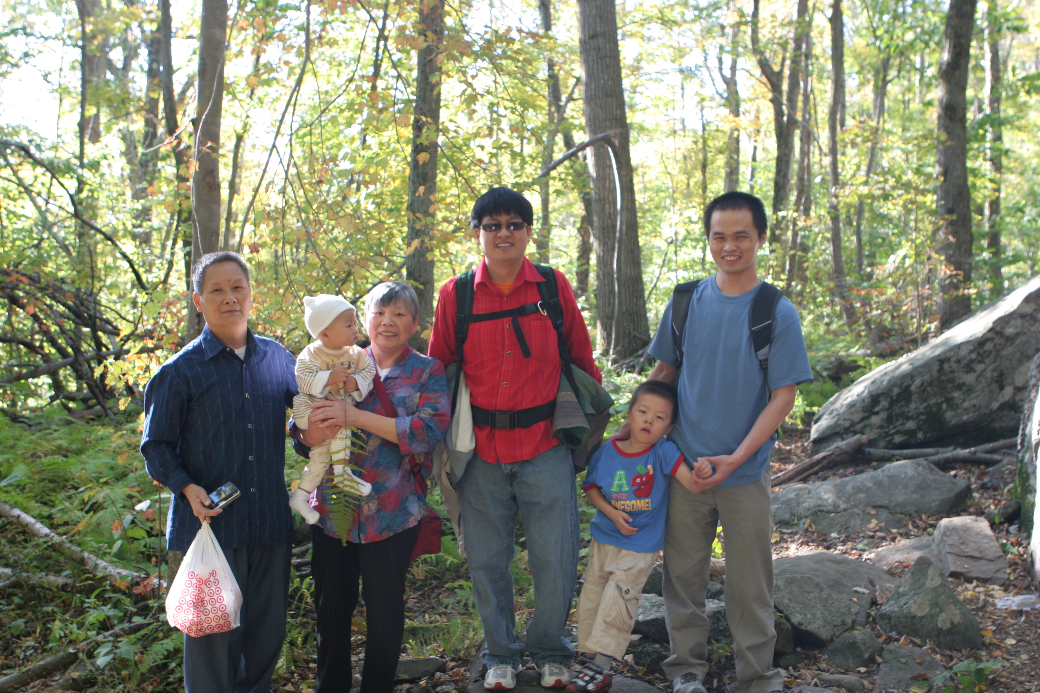
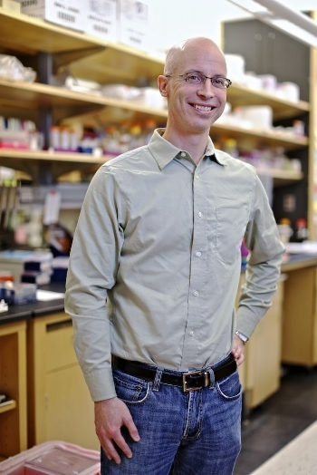
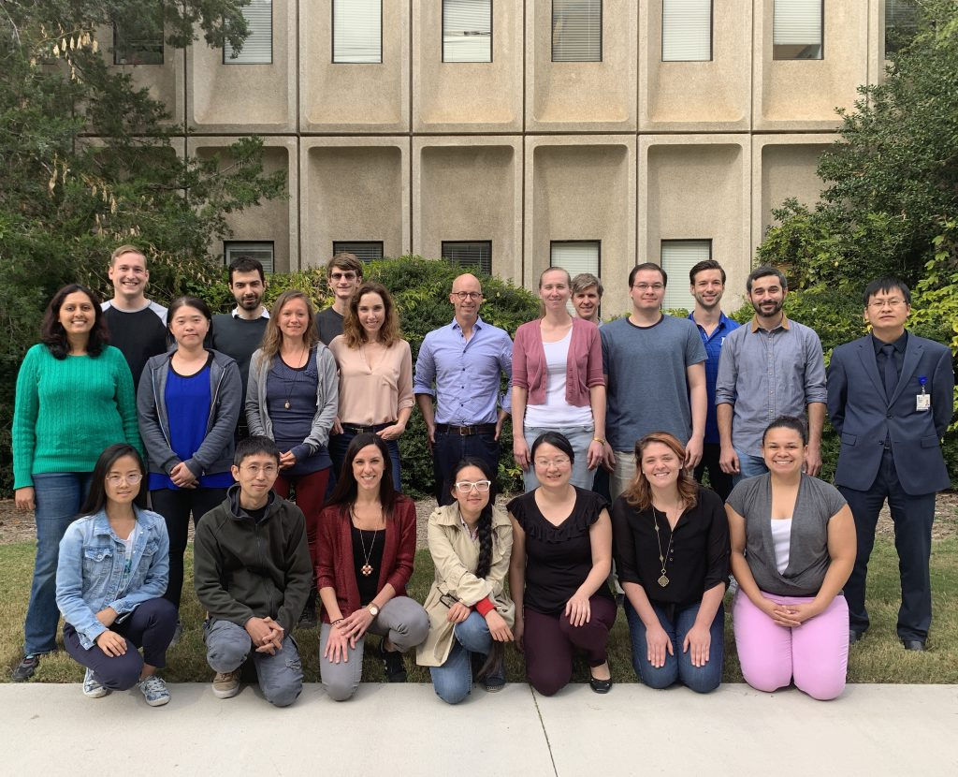
Acknowledgement
Notes:
I would like to thanks
Haibo, PhD,
Amy Dickson,
Kenneth D. Poss, Ph.D.
Julie Zhu, Ph.D.
Jun Yu, Ph.D
And all the lab members in Poss lab.
Thank you for your attention.

